Slide 1
Group 1
Design and Innovation Project

Slide 2

Ideas Formulated
3D Virtual Classroom
Whiteboard
Questionnaire

Slide 3

3D Virtual Classroom

Slide 4
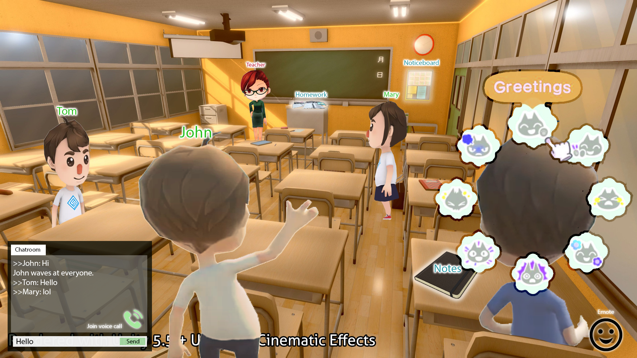
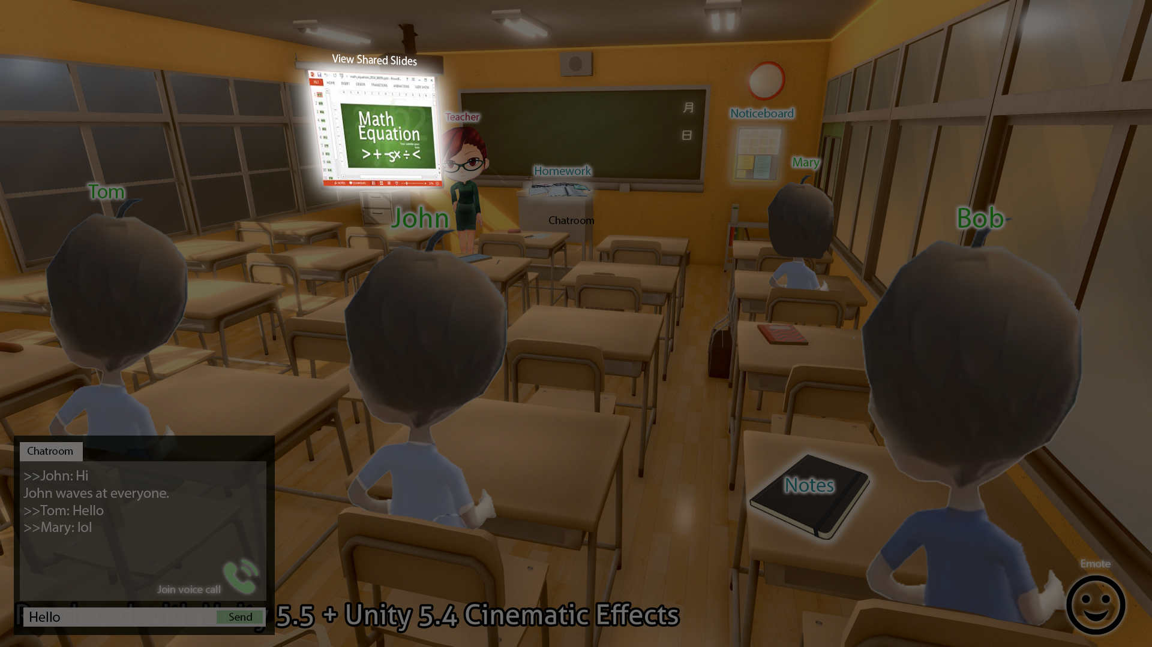
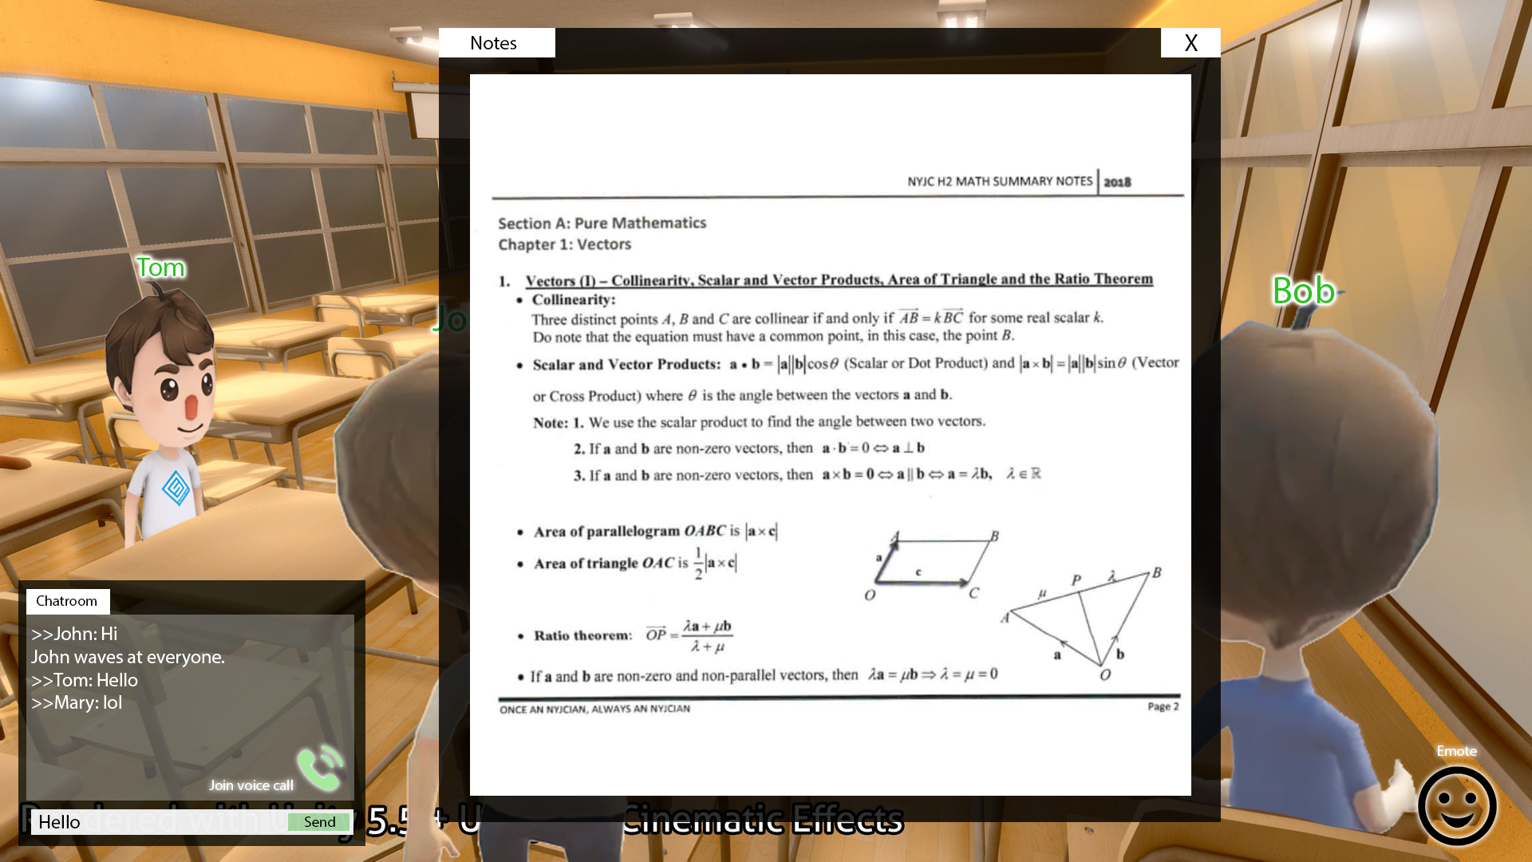
3D Virtual Classroom
Features
Objective
To make online lessons more engaging
Target primary / secondary school students
3D Model of a Classroom
Customizable Avatars
Interaction with others / classroom (emotes, actions, voice/ text chat) e.g. raise hand to ask a question, pick paper to look at the notes
Classroom elements e.g. Tutor can conduct a video call/ share their screen on virtual projector
Rules and Regulations e.g. Tutor can enforce students to mute / sit when presenting
Perspectives Tutor: toggle between classroom view and slide sharing view Students: toggle between fullscreen and class view
In-game currency Tutors can reward students who answer questions Students can buy virtual items (e.g. laptops, avatar customization options)

Slide 5

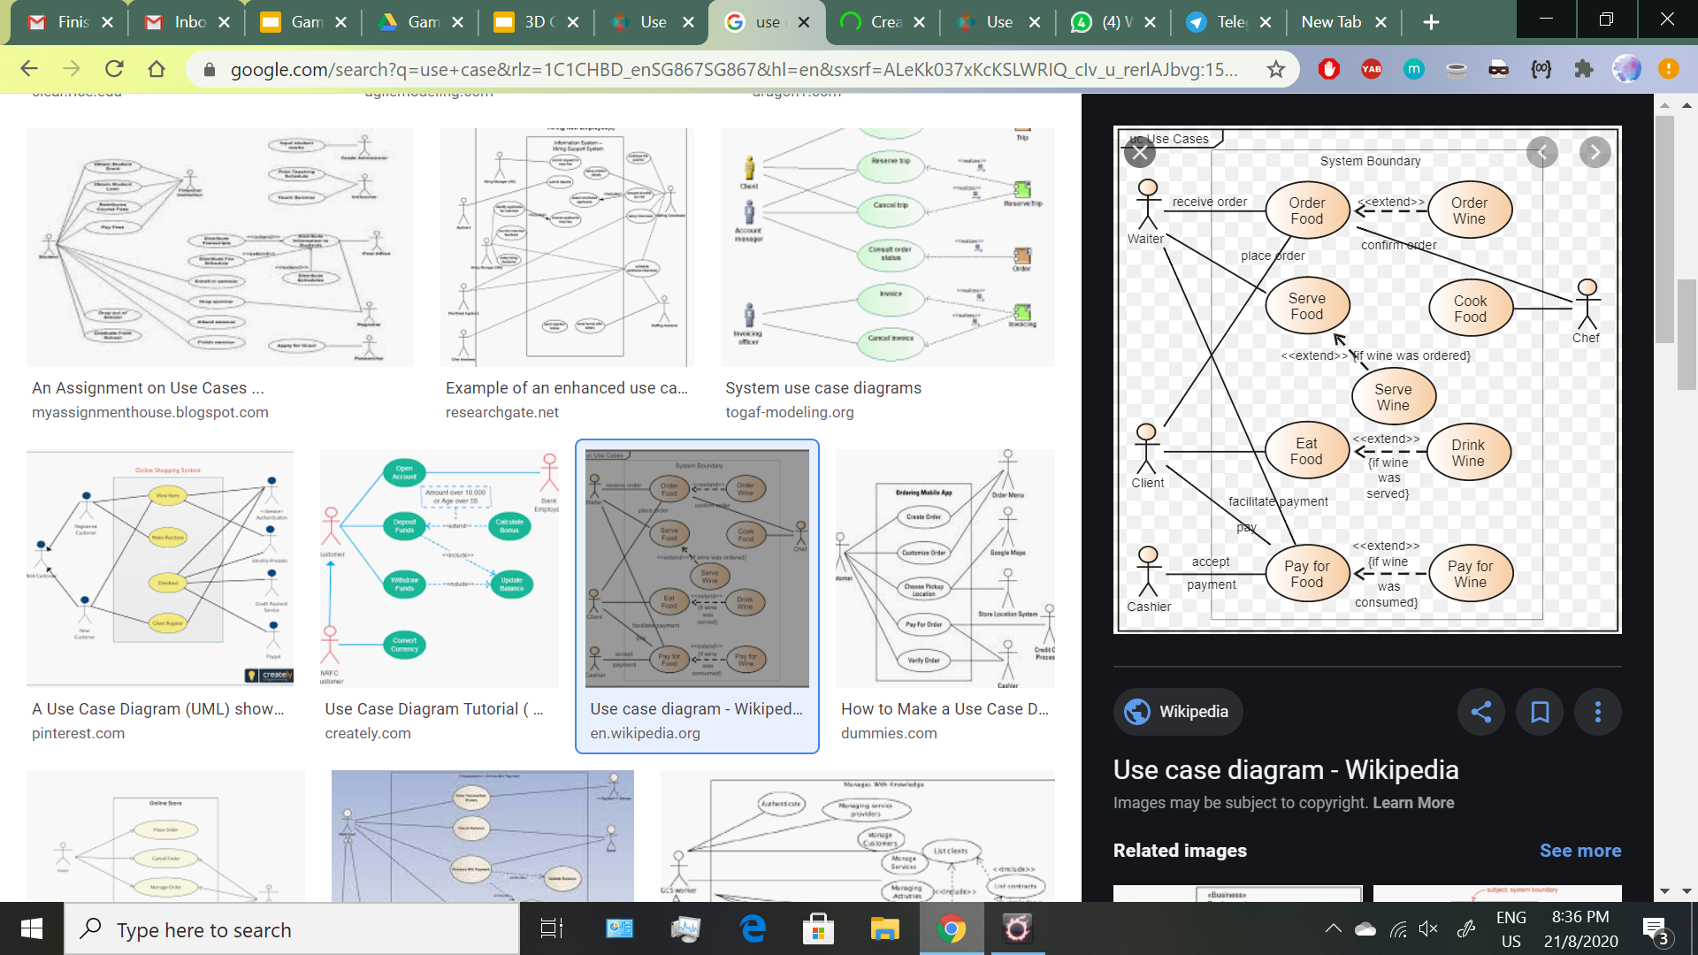

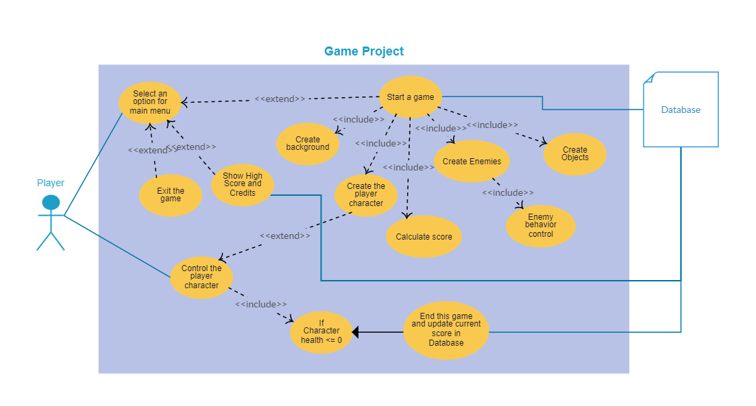
Use-Case
Create/
Log In Account
Control Access
Upload Lesson Materials
Distribute In-game Currency
View materials
(if given access)
Interact via emotes
Teacher (Admin)
Create/Edit Avatar
(If material uploaded)
Control avatar movement
Buy In-game items
(if given access)
(if currency sufficient)
(if given access)
(if given access)
Screenshare
Chat (text/voice)
Annotate whiteboard
Student

Slide 6
Possible Software - Unity
3D Modelling
Buy assets from unity store or import assets from online
Creating with blender
Pros
Game, it’s fun :D
Cons
Need to retrieve information
Not sure if it supports voice, video, chat, screen sharing
Security Issues
Notes:
https://www.slant.co/topics/7239/~engines-for-easily-creating-online-multiplayer-games
https://meliorgames.com/game-development/back-end-solutions-multiplayer-games/

Slide 7

WhiteBoard

Slide 8
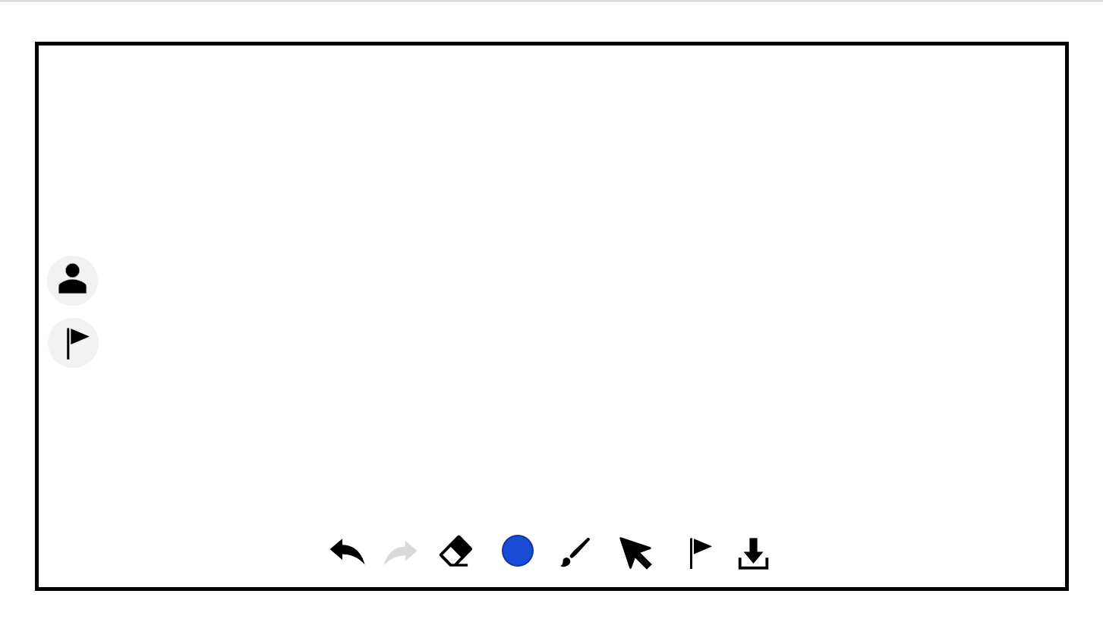

What is WhiteBoard?
collaborative annotating tool
allow simultaneous annotators, with permission from host
with version control, which produces downloadable saved checkpoints

Slide 9
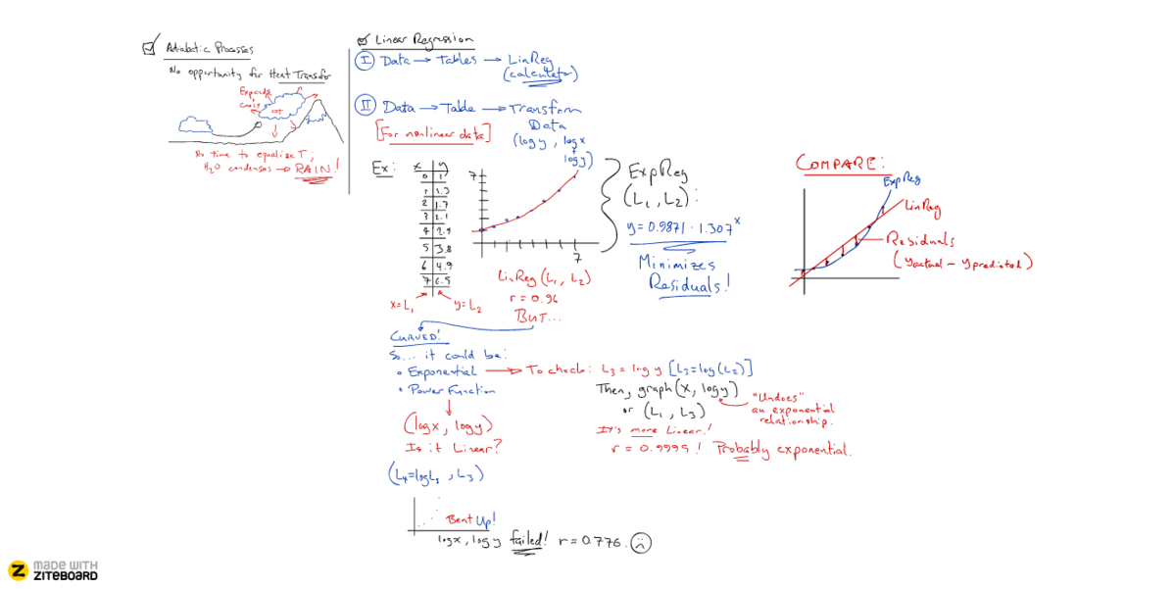
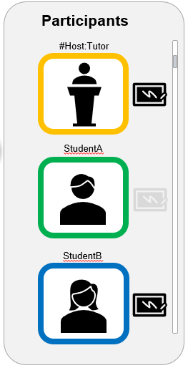
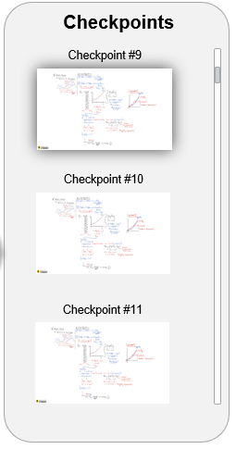



















Slide 10
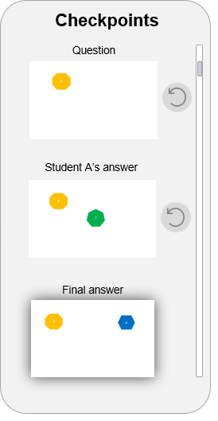
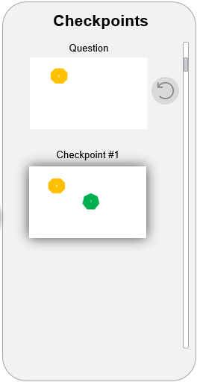
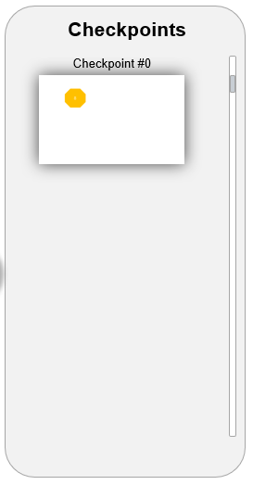
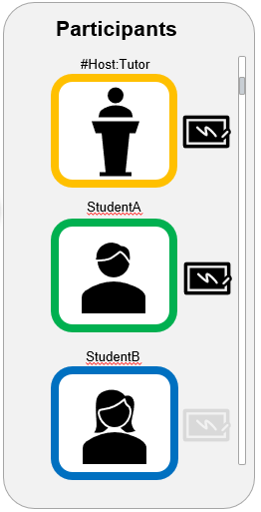




USE CASE

Slide 11

Questionnaire

Slide 12


Questionnaire
Objectives
To supplement students’ learning by reinforcing concepts taught through the use of interactive questions
Encourage learning through the use of leaderboards and in-game incentives
Features
Each module is tagged to a specific map. Each map contain levels. Each level indicates a 5 question related to the module. The higher the level the more difficult the questions
Allow students to match against one another on the same breadth of questions
The student lose “ELO” whenever he loses a match against others. The rank system resets at the end of every week and medals are given to students with the highest “ELO”
Medals would change at the end of every week (ensure uniqueness)

Slide 13

Winners
Users
Competitive:
Match with other users
Results
(Scoreboard)
Determine by total marks
Attempt
Losers
In-game Medal
Create Account
Practice:
Questions
Educational Institute
Set

Slide 14
Software to be used
Future Improvements
For App Development
- Android Studio
- Swift
Integrated into a Web App
Practice Question Type :
Memorising / Understanding Concept
Data Storing
Collaboration with other Institution
- Firebase
- SQL
Forum for users to discuss questions
Students able to set practice questions

Slide 15
The End
Thank you very much!

